Slide 1
Team Sorta Math Finance
Andrew Haskett, Katrina Hartley, Luke Nigro, Felipe Veloso
University of North Carolina at Charlotte

Slide 2
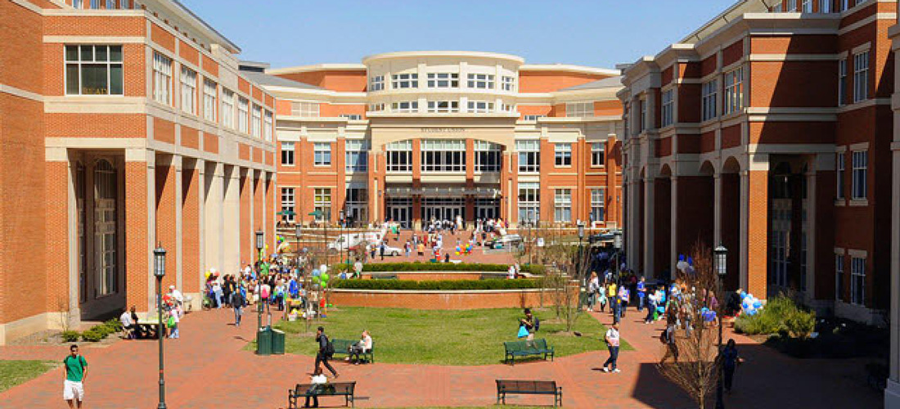
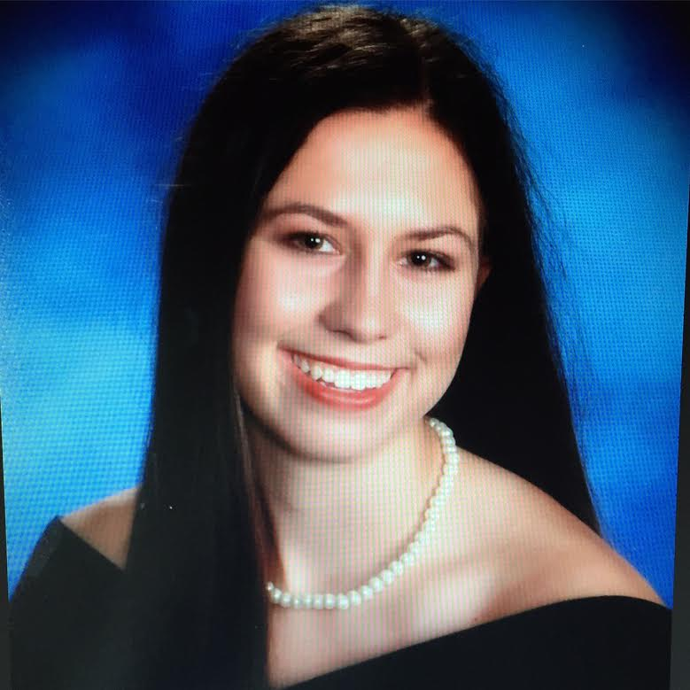



(Will get a legit group photo on campus when our schedules don’t collide)

Slide 3
Online Resources
-Github for the front end and back end code: https://github.com/redsock88/itcs-6160-final-project
-Location of the SQL dump file: https://github.com/redsock88/itcs-6160-final-project/blob/master/dumpfile.sql
-Video demo of the code: https://www.youtube.com/watch?v=GAKYA6RQRww

Slide 4
Scope and Use Cases
Our group is aiming to maximize the quality of the Niner Rides Golf cart service. In order to achieve this, we will analyze golf cart metrics through the following Use Cases:
Track ride quality
Analyze the most popular locations
We are creating 8 normalized tables: Persons (breaking down into Students, Faculty, and staff tables), Cart, Location, Rides, Rating, and Payments with rating and payments weak entities to the Rides table. Through these tables, we’ll define set business requirements and schemas enabling us to join the necessary Golf cart data needed.

Slide 5
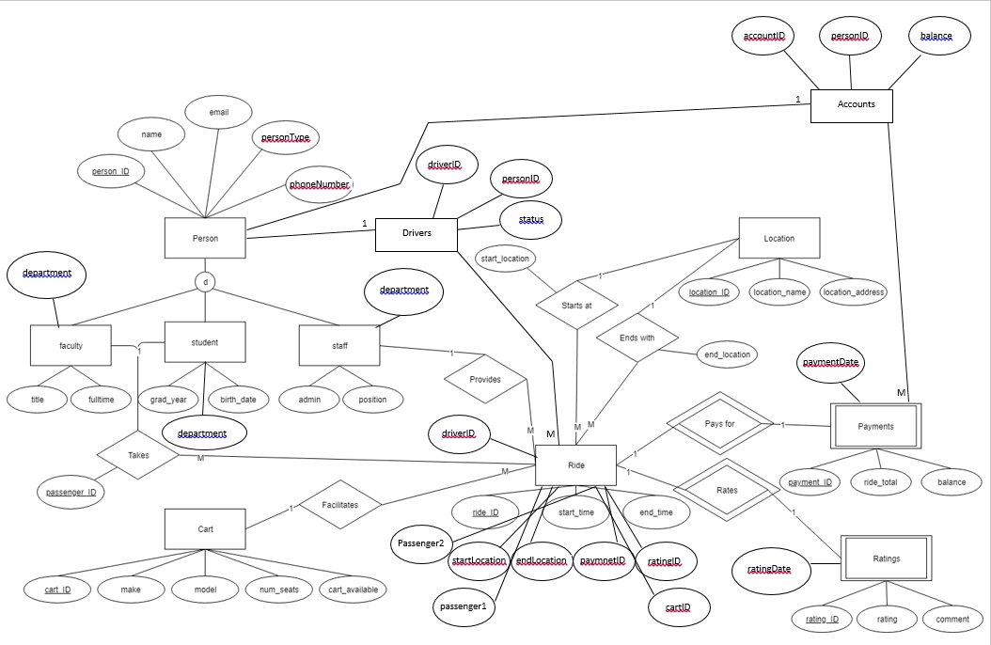
EERD Fully Normalized

Slide 6
Business Requirements (per entity)
Students: Can take a ride but can`t be a driver;
Faculty: Can take a ride but can`t be a driver;
Staff: Can be a driver but can`t be a passenger;
Drivers: All the drivers must be staff members, not all the staff members are drivers;
Carts: It is possible to add and remove carts from the list;
Rides: All the rides must be on the campus;
-Each ride must have one driver and at least one passenger;
-Each ride must have a payment ID;
-Each ride may have a rating ID (could be NULL)
-Each ride must have a max. of 2 passengers;
-Each ride must have a start and end points;
Ratings: The range will be from 1 to 5 (based on UBER);

Slide 7
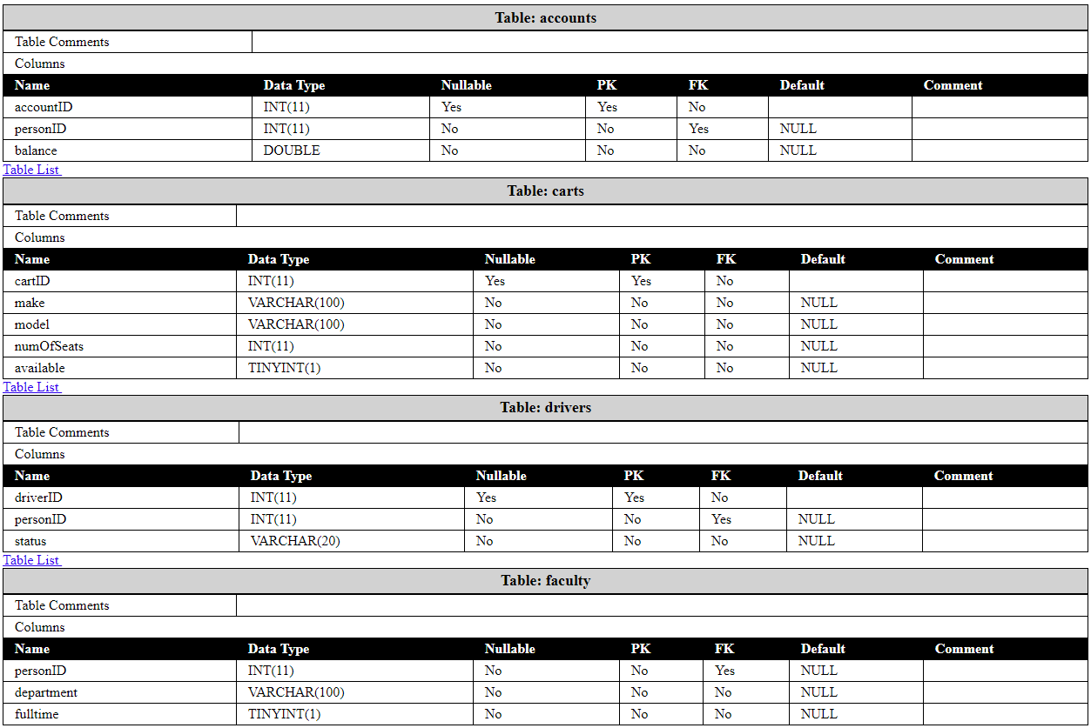
Data Dictionary

Slide 8
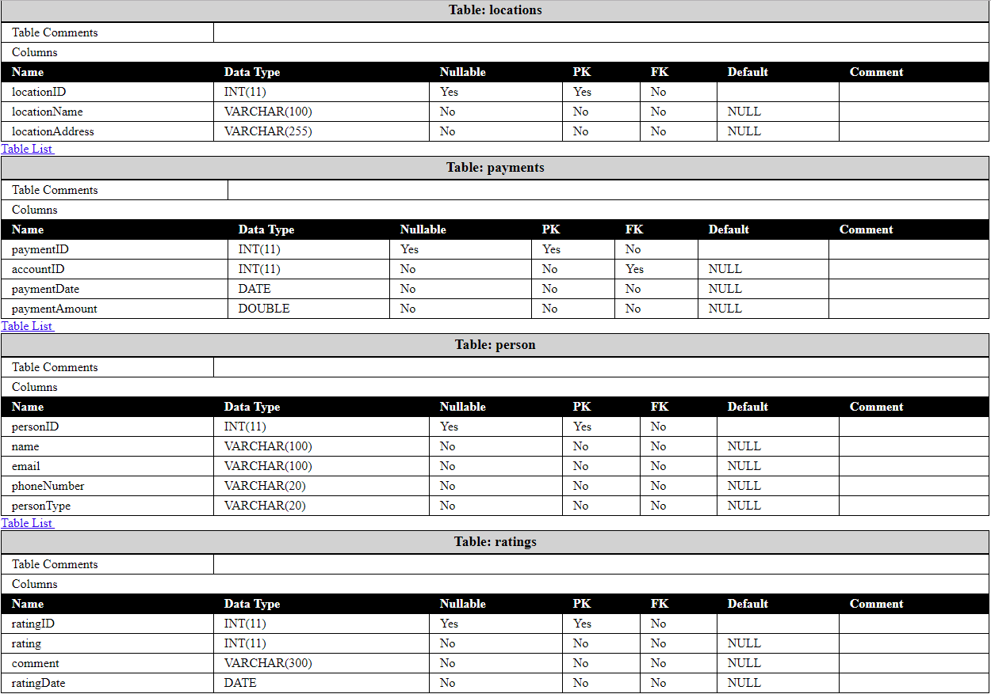
Data Dictionary cont.

Slide 9
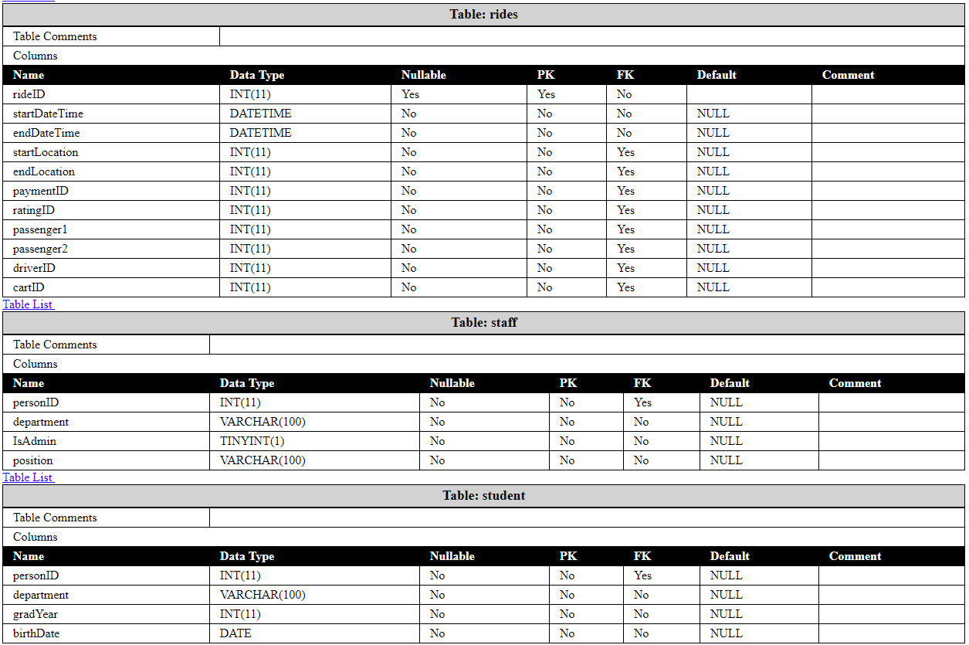
Data Dictionary cont.

Slide 10
Stored Procedures
Add_payment(ride, account, amount)
Creates a new record in the payments table
Stores the payment amount and applies it to a ride and account
Triggers update_balance which updates the balance field in the account table
All fields are required
Add_rating(ride, rating, comment)
Creates a new record in the ratings table
Stores the rating and comment on a give ride.
The comment field is not required and defaults to null
Add_ride(startDateTime, endDateTime, startLocation, endLocation, passenger1, passenger2)
Creates a new record in the rides table
User adds the start and end times and locations as well as the ride passengers
All fields are required except passenger2 which defaults to null
Modify_ride(ride, startDate, endDate, sLocation, eLocation, pass1, pass2)
Updates a record in the rides table
Utilizes the same fields as the add_ride procedure and requires a ride ID as well
All fields are required except pass2
Remove_ride(ride)
Deletes a record in the rides table, according to the specified ride ID

Slide 11
Trigger
update_balance
Is activated automatically after a payment record is created
Can happen through transactions, through the add_payment procedure, or through the UI.
Updates the current balance in the account table to reflect the new payment
If account balance is negative, the account owner has a credit on their account.

Slide 12
Views
all_rides
Displays the rides table with all IDs displayed as their actual values
i.e. locationIDs in startLocation are replaced with the names of the corresponding locations
all_payments
Displays all of the payments made over time by all users
Payments are displayed in ascending order by personID
Replaces personIDs with the names of the Payees
Is updated when the update_balance trigger is activated
all_drivers
Displays the personal details of the drivers in the drivers table.

Slide 13
Query Optimization
all_rides
Inner joins used to match optional fields
All joins are done on index values which are integers and quick to be matched
all_payments
Inner joins used to match optional fields
all_drivers
Instead of joining this view employs a fairly quick subquery

Slide 14
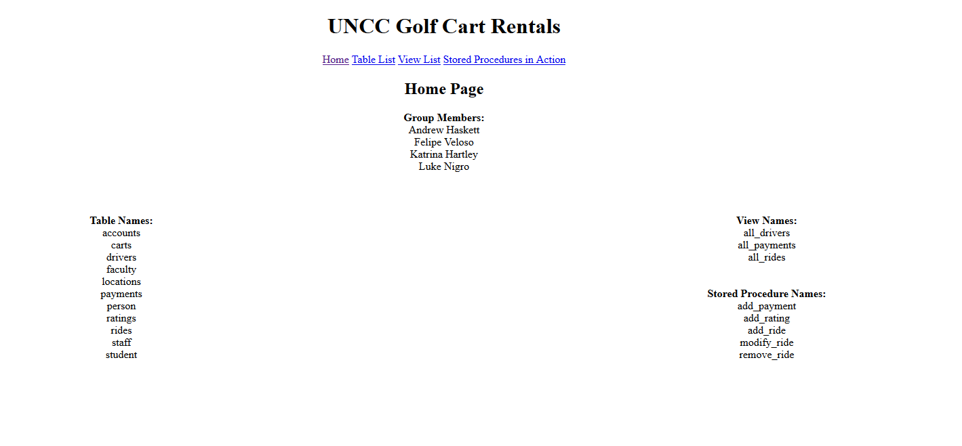
UI – Home Page

Slide 15
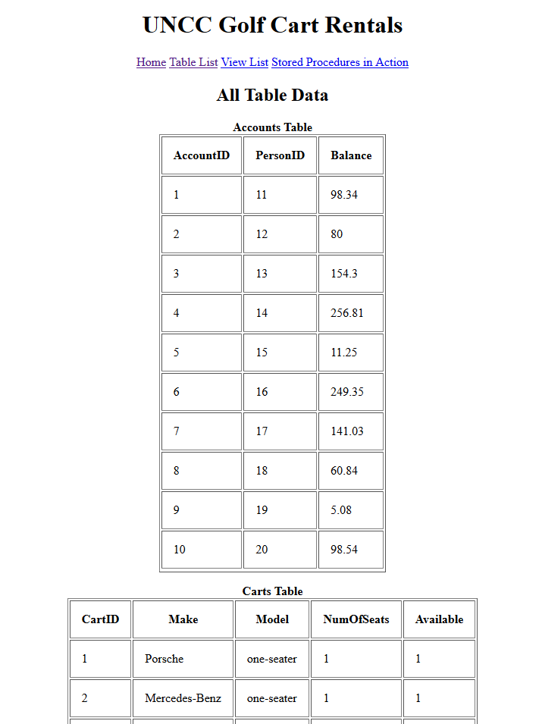
UI – Table List Page

Slide 16
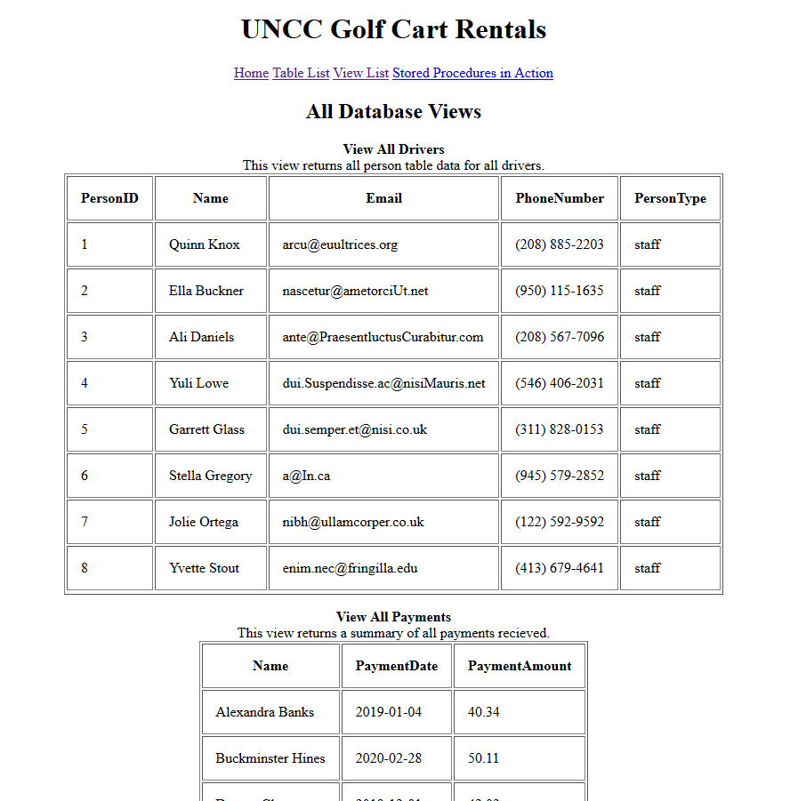
UI – View List Page

Slide 17
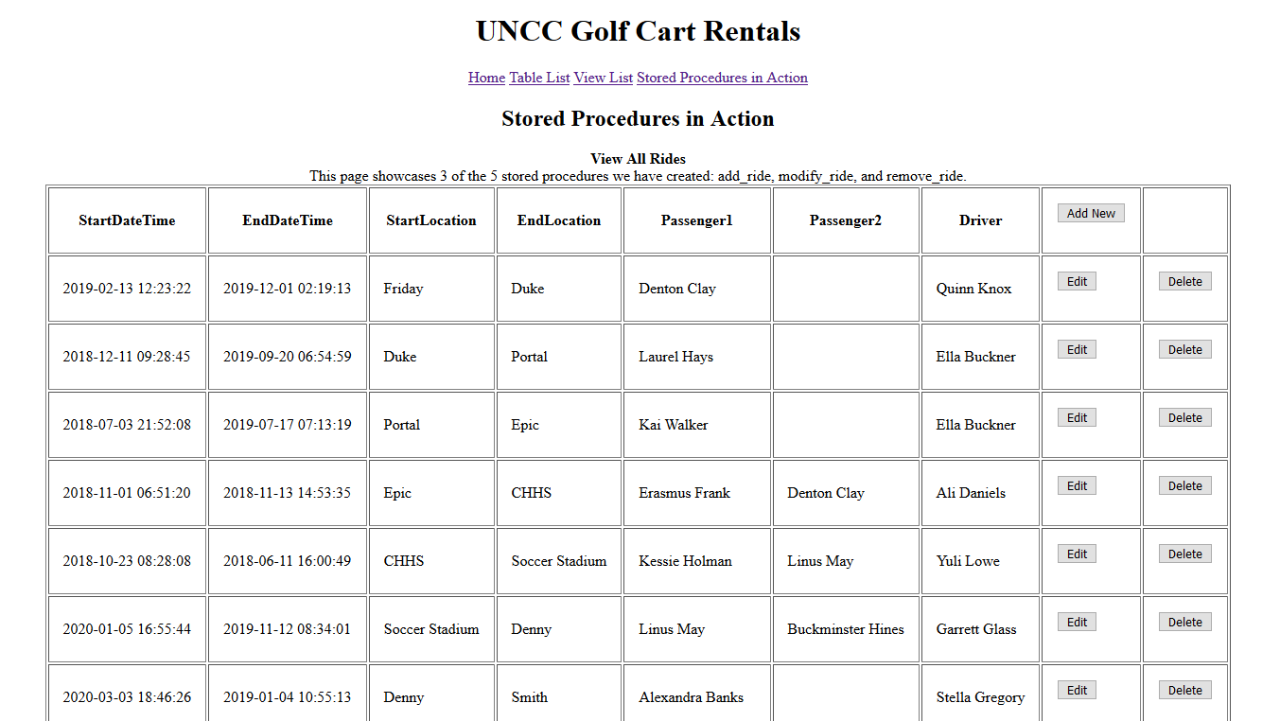
UI – Stored Procedure Action Page

Slide 18
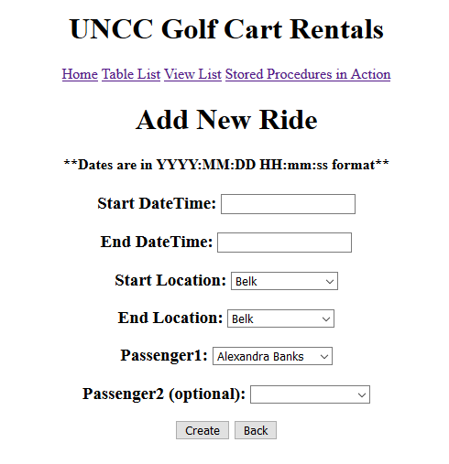
UI – Stored Procedure Action Page(cont.)

Slide 19
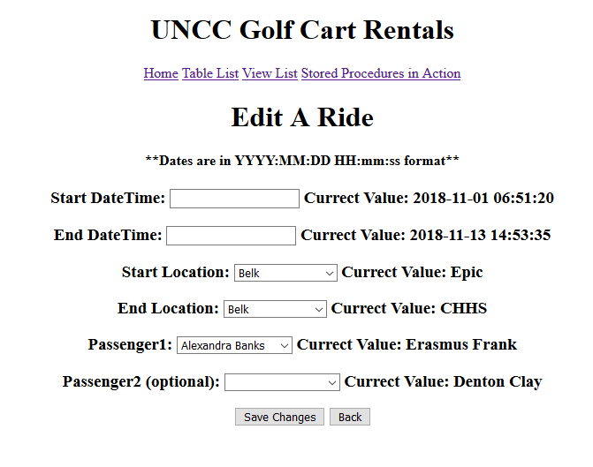
UI – Stored Procedure Action Page(cont.)

